Slide 1
Journey Planner
By: Sahil Patel

Slide 2

Introduction to the Problem
Travel Route Optimization Problem
Shortest Path Problem

Slide 3

Dijkstra Algorithm
Priority Queue
Edge Relaxation
Optimality and Completeness

Slide 4

Advantages of Dijkstra Algorithm
Dijkstra's algorithm is highly efficient for finding the shortest path in graphs with non-negative weights. It uses a priority queue to continuously select the next node with the smallest tentative distance, ensuring that each node's shortest path is finalized in the least amount of time possible
The Algorithm not only calculates the shortest distances but also allows for easy reconstruction of the path taken. This is accomplished through backtracking from the destination node to the source node using pointers or references to preceding nodes. This feature is particularly useful in route planning applications where users require not just the travel distance but also the specific route to follow.

Slide 5
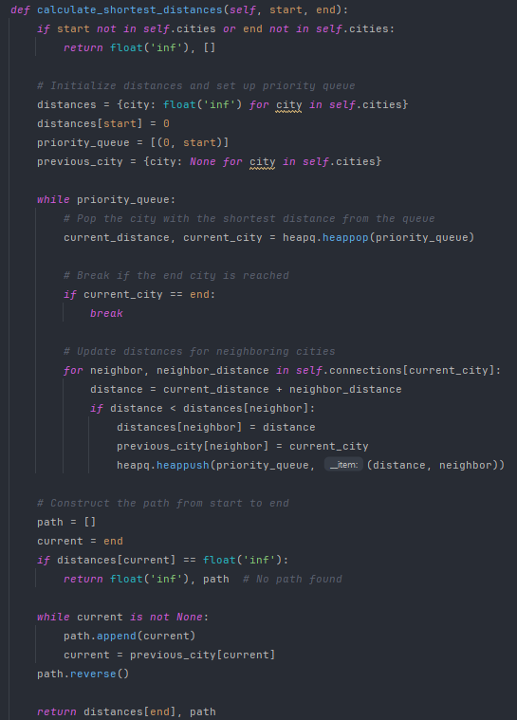
Breakdown

Slide 6
Alternative Algorithm
Bellman-Ford Algorithm: This algorithm could be considered if there were potential negative weights in the graph, as it can handle them and also detect negative cycles.
Multi-Criteria Optimization: For a more sophisticated approach, algorithms that consider multiple factors like cost and time could be used to provide more personalized route recommendations.
A* Algorithm: A* uses a heuristic to estimate the distance to the goal, focusing the search on more promising paths and potentially reducing the number of nodes evaluated.

Slide 7

Demonstration

